Slide 1
Susan Elster Jones

Slide 2
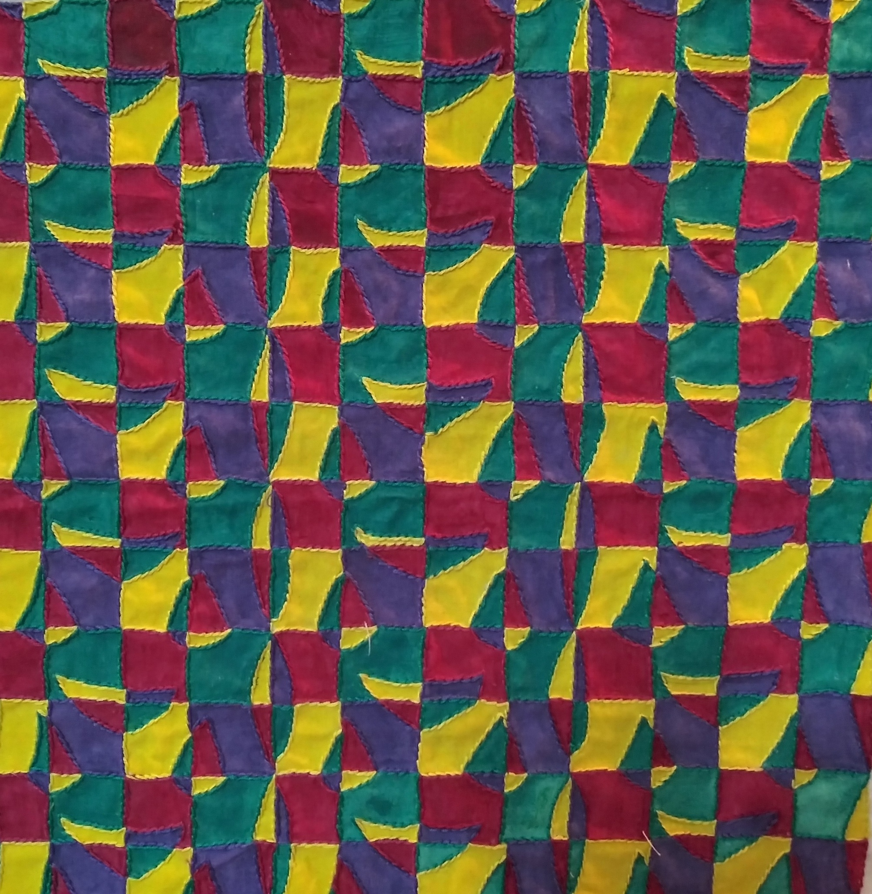
1986
My first stitching obsession

Slide 3
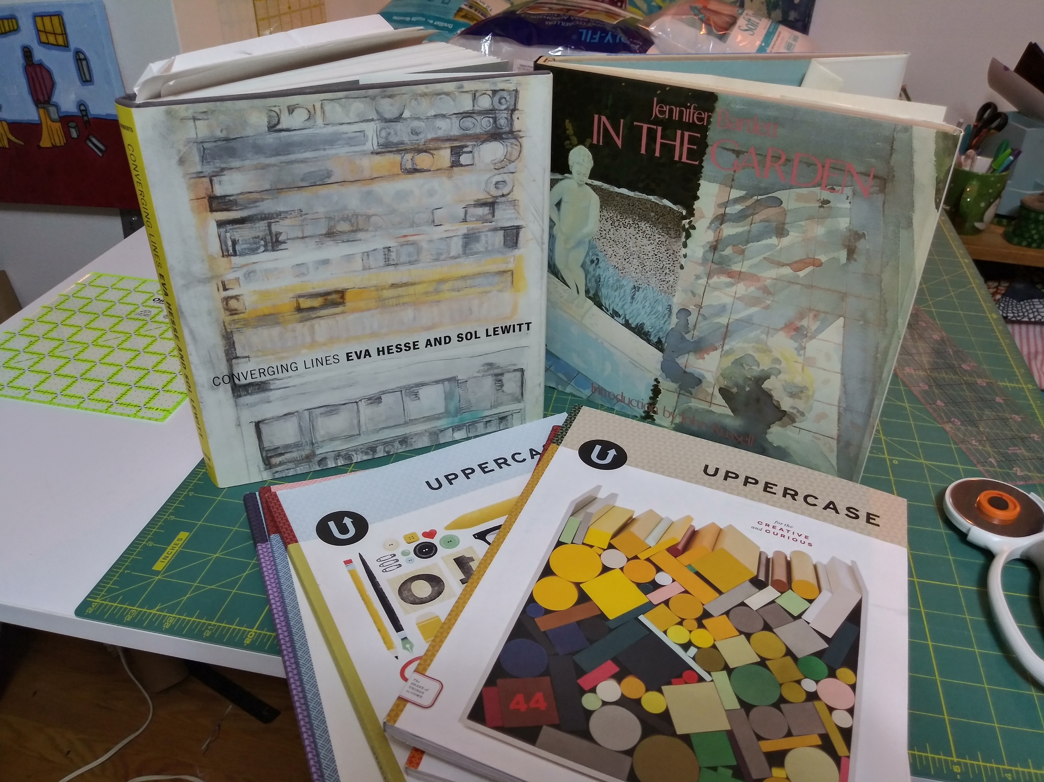
Sources of Inspiration

Slide 4
Our Living Room

Slide 5
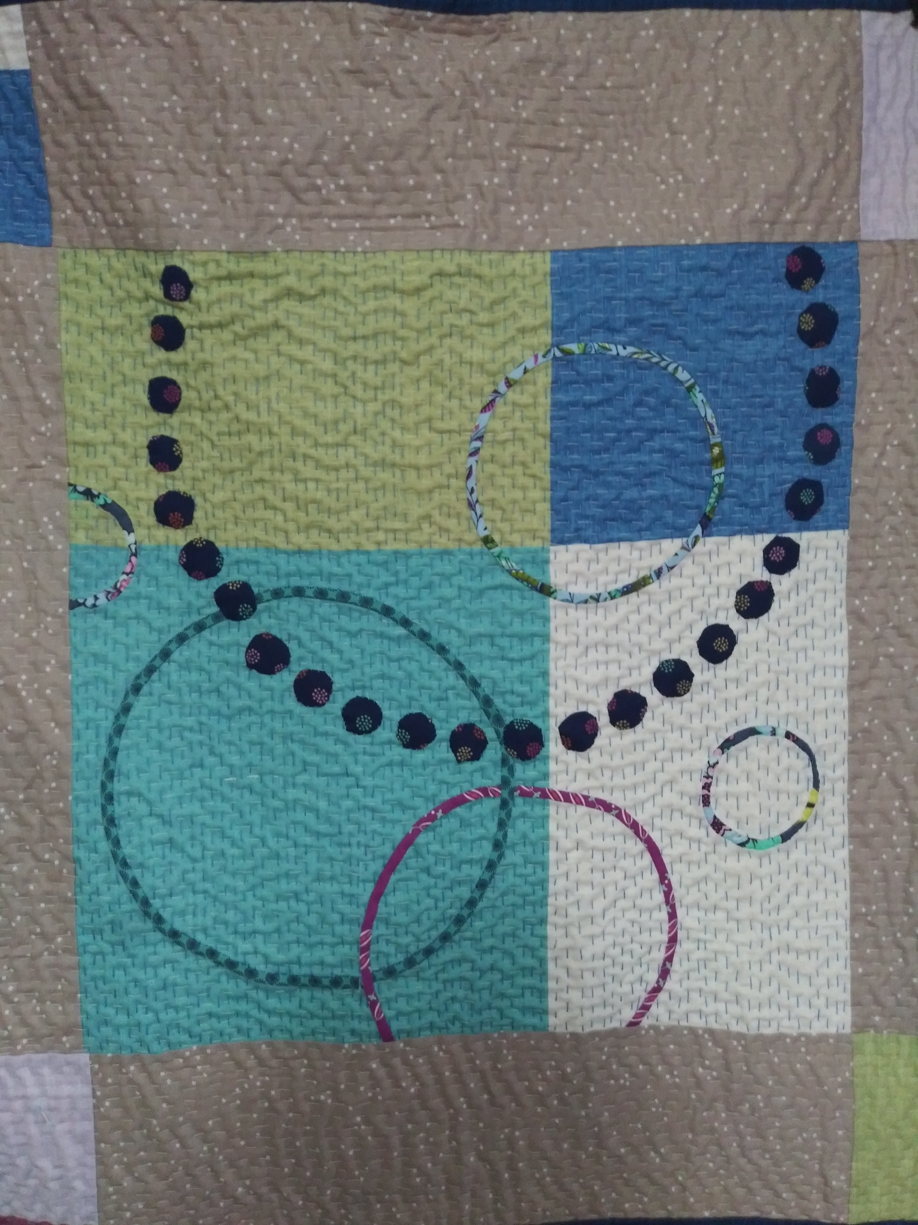
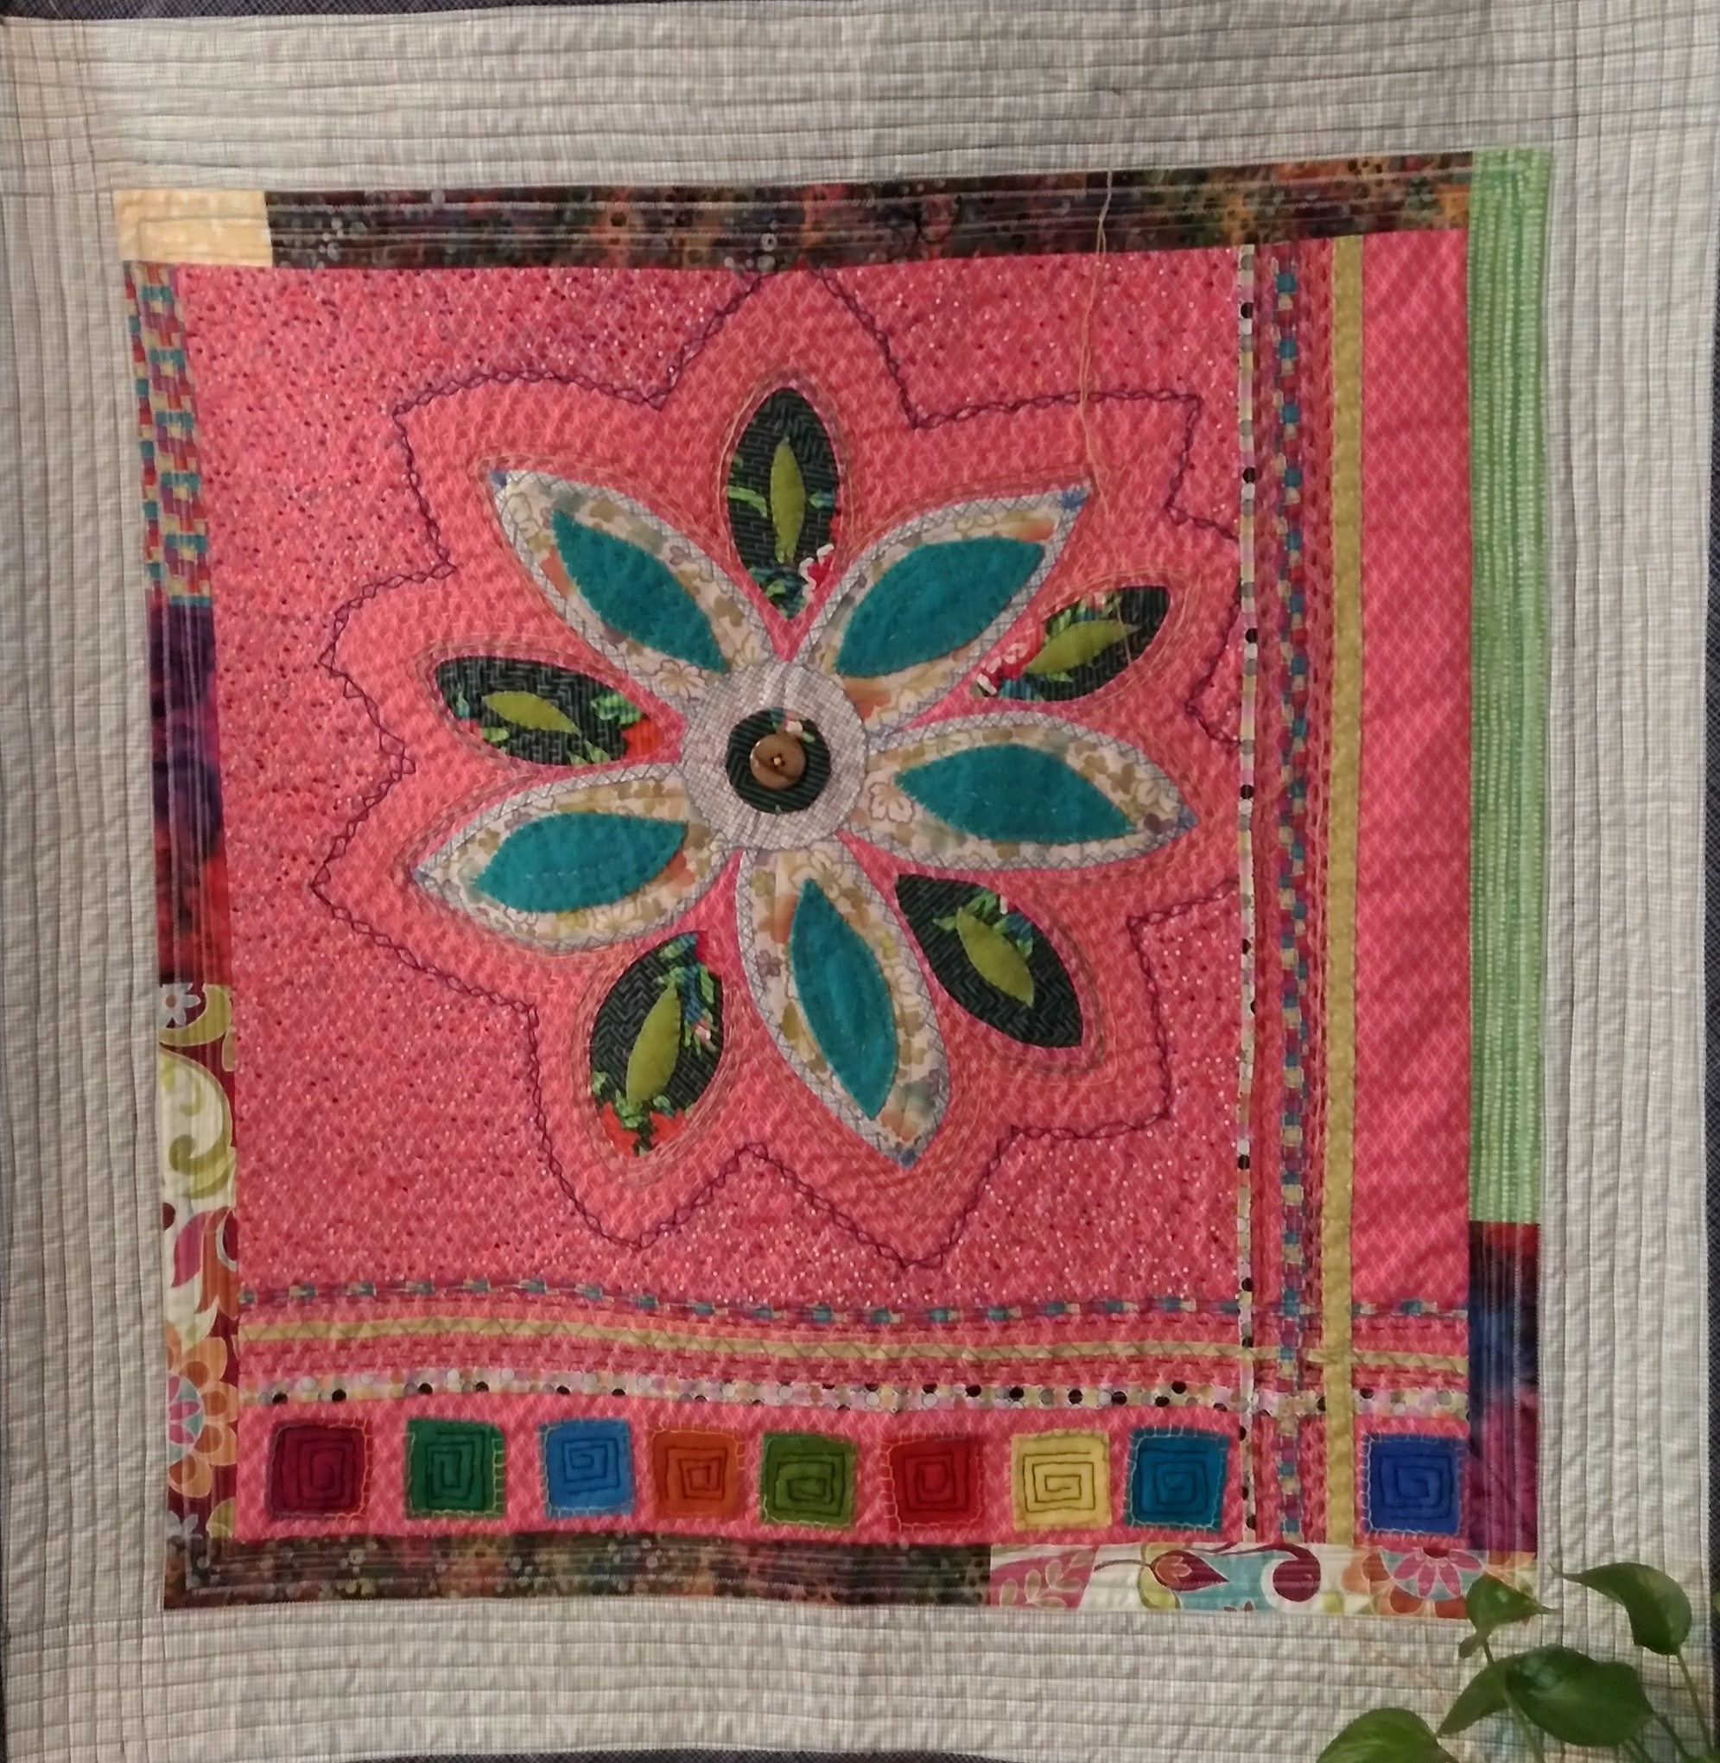
Debbie Grifka Workshops

Slide 6
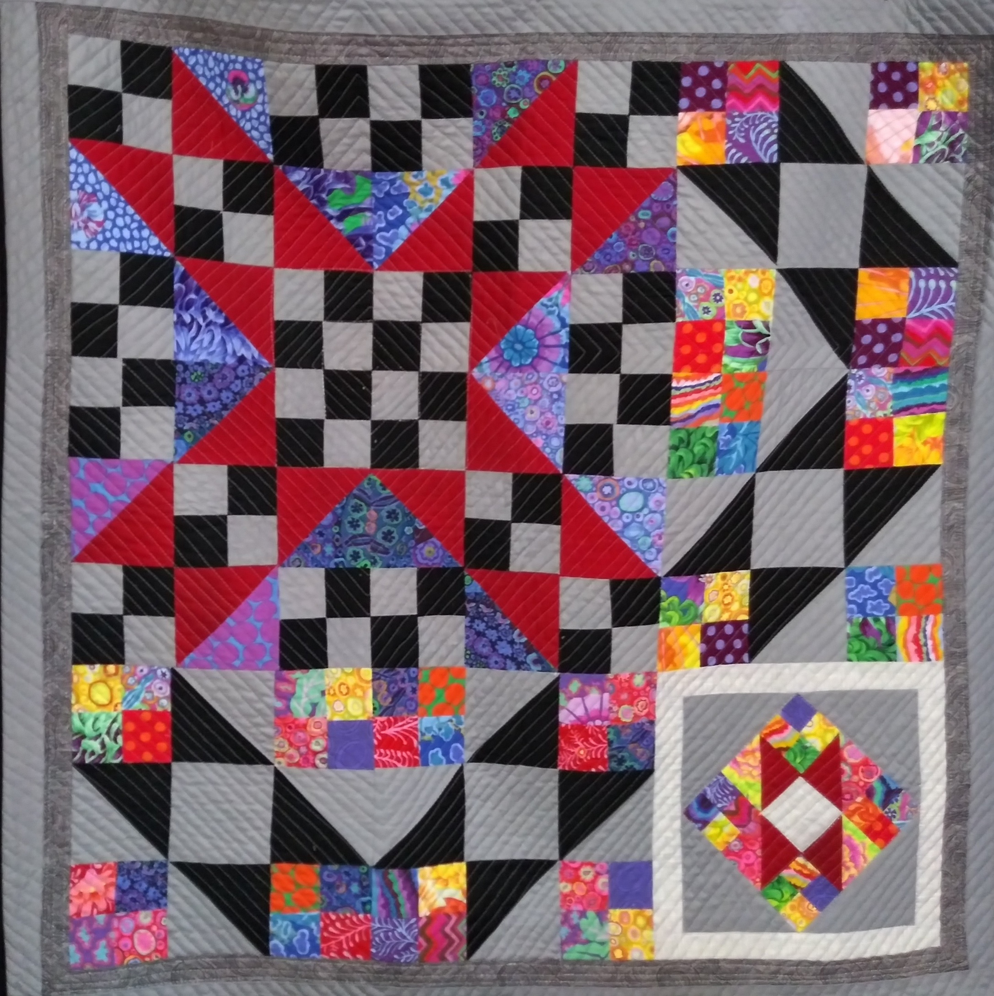
SCQG Challenge Quilt

Slide 7
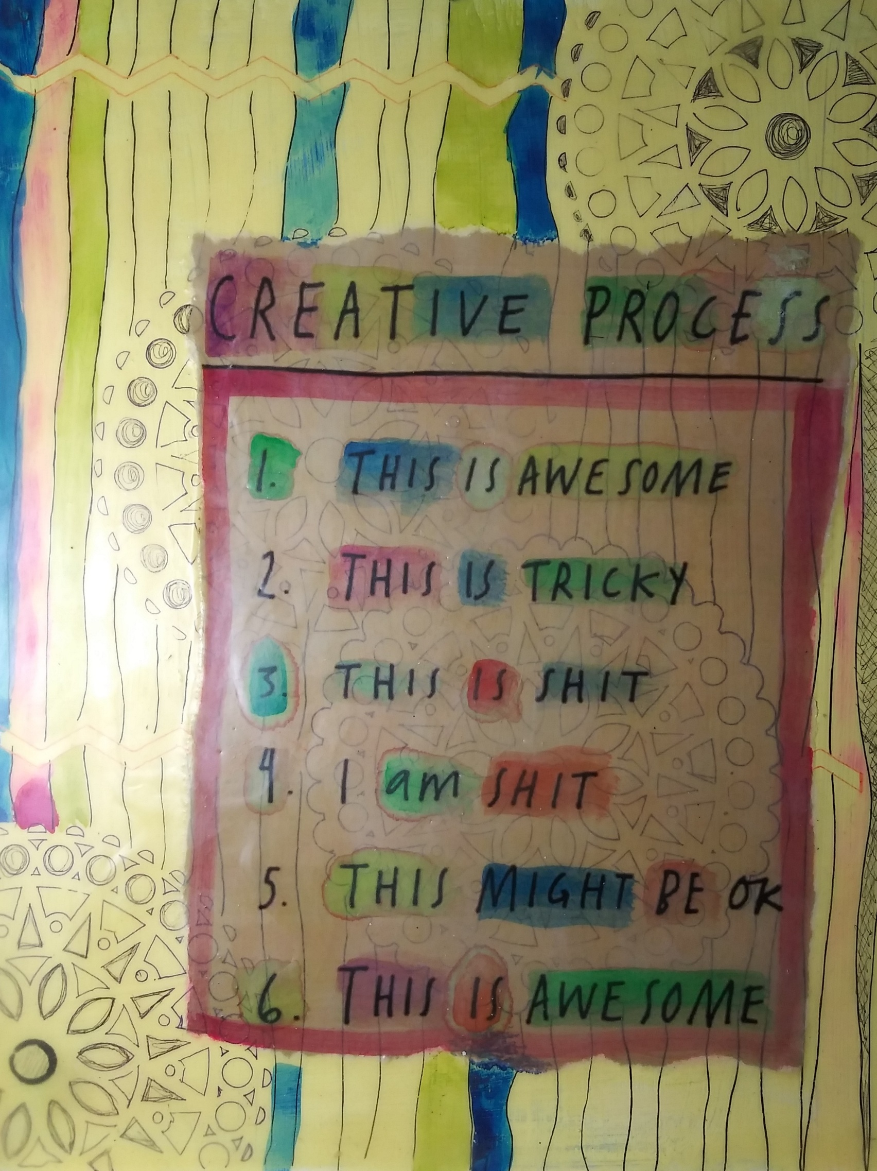
An inspiration quote that I love

Slide 8
Mixed media pieces

Slide 9
Mixed media pieces

Slide 10
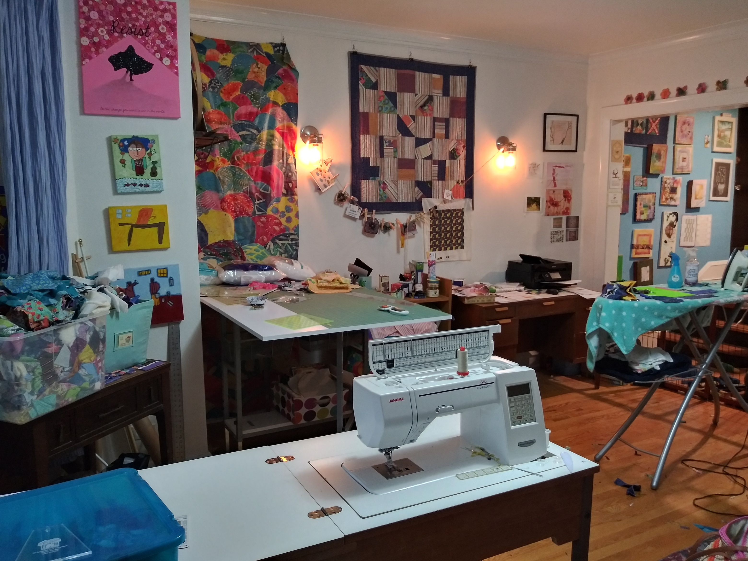
studio

Slide 11
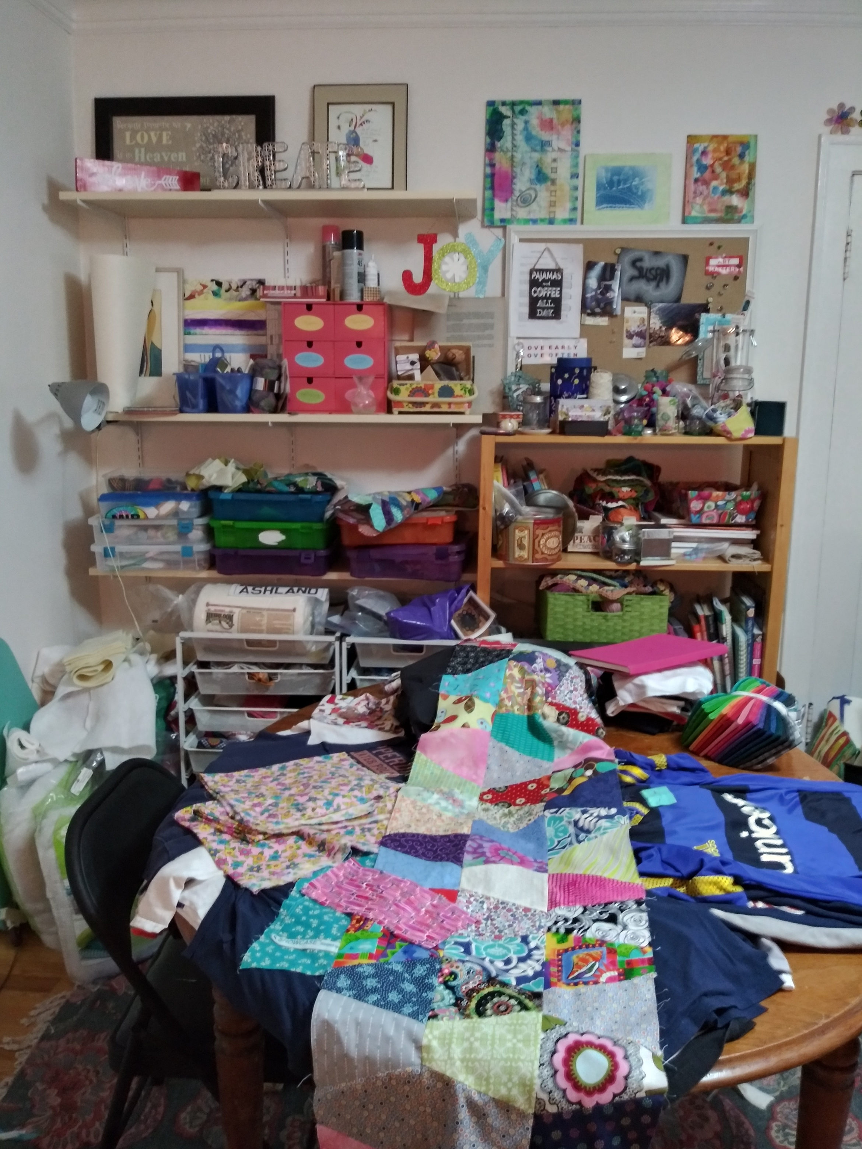
Studio

