Slide 1
Trunk Show
DeAnn Ellis
July 27, 2020

Slide 2
My history
I’ve been quilting about 19 years, but I’ve sewn all my life.
My Mom taught me and let me use her sewing machine anytime I wanted.
But quilting was something entirely different for me. And I’ve kept a record… at least for the 1st 10 years.

Slide 3
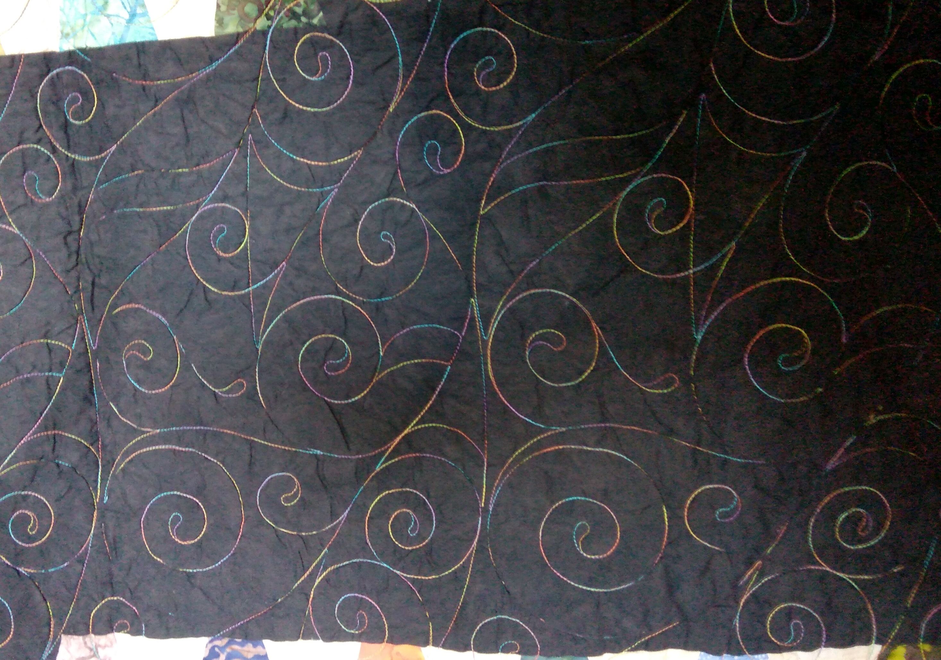
My Quilts In no order whatsoever…
I love this quilt! I created it from precut sale tumblers and garage sale background!
I’m keeping this one!
Love this quilting!

Slide 4
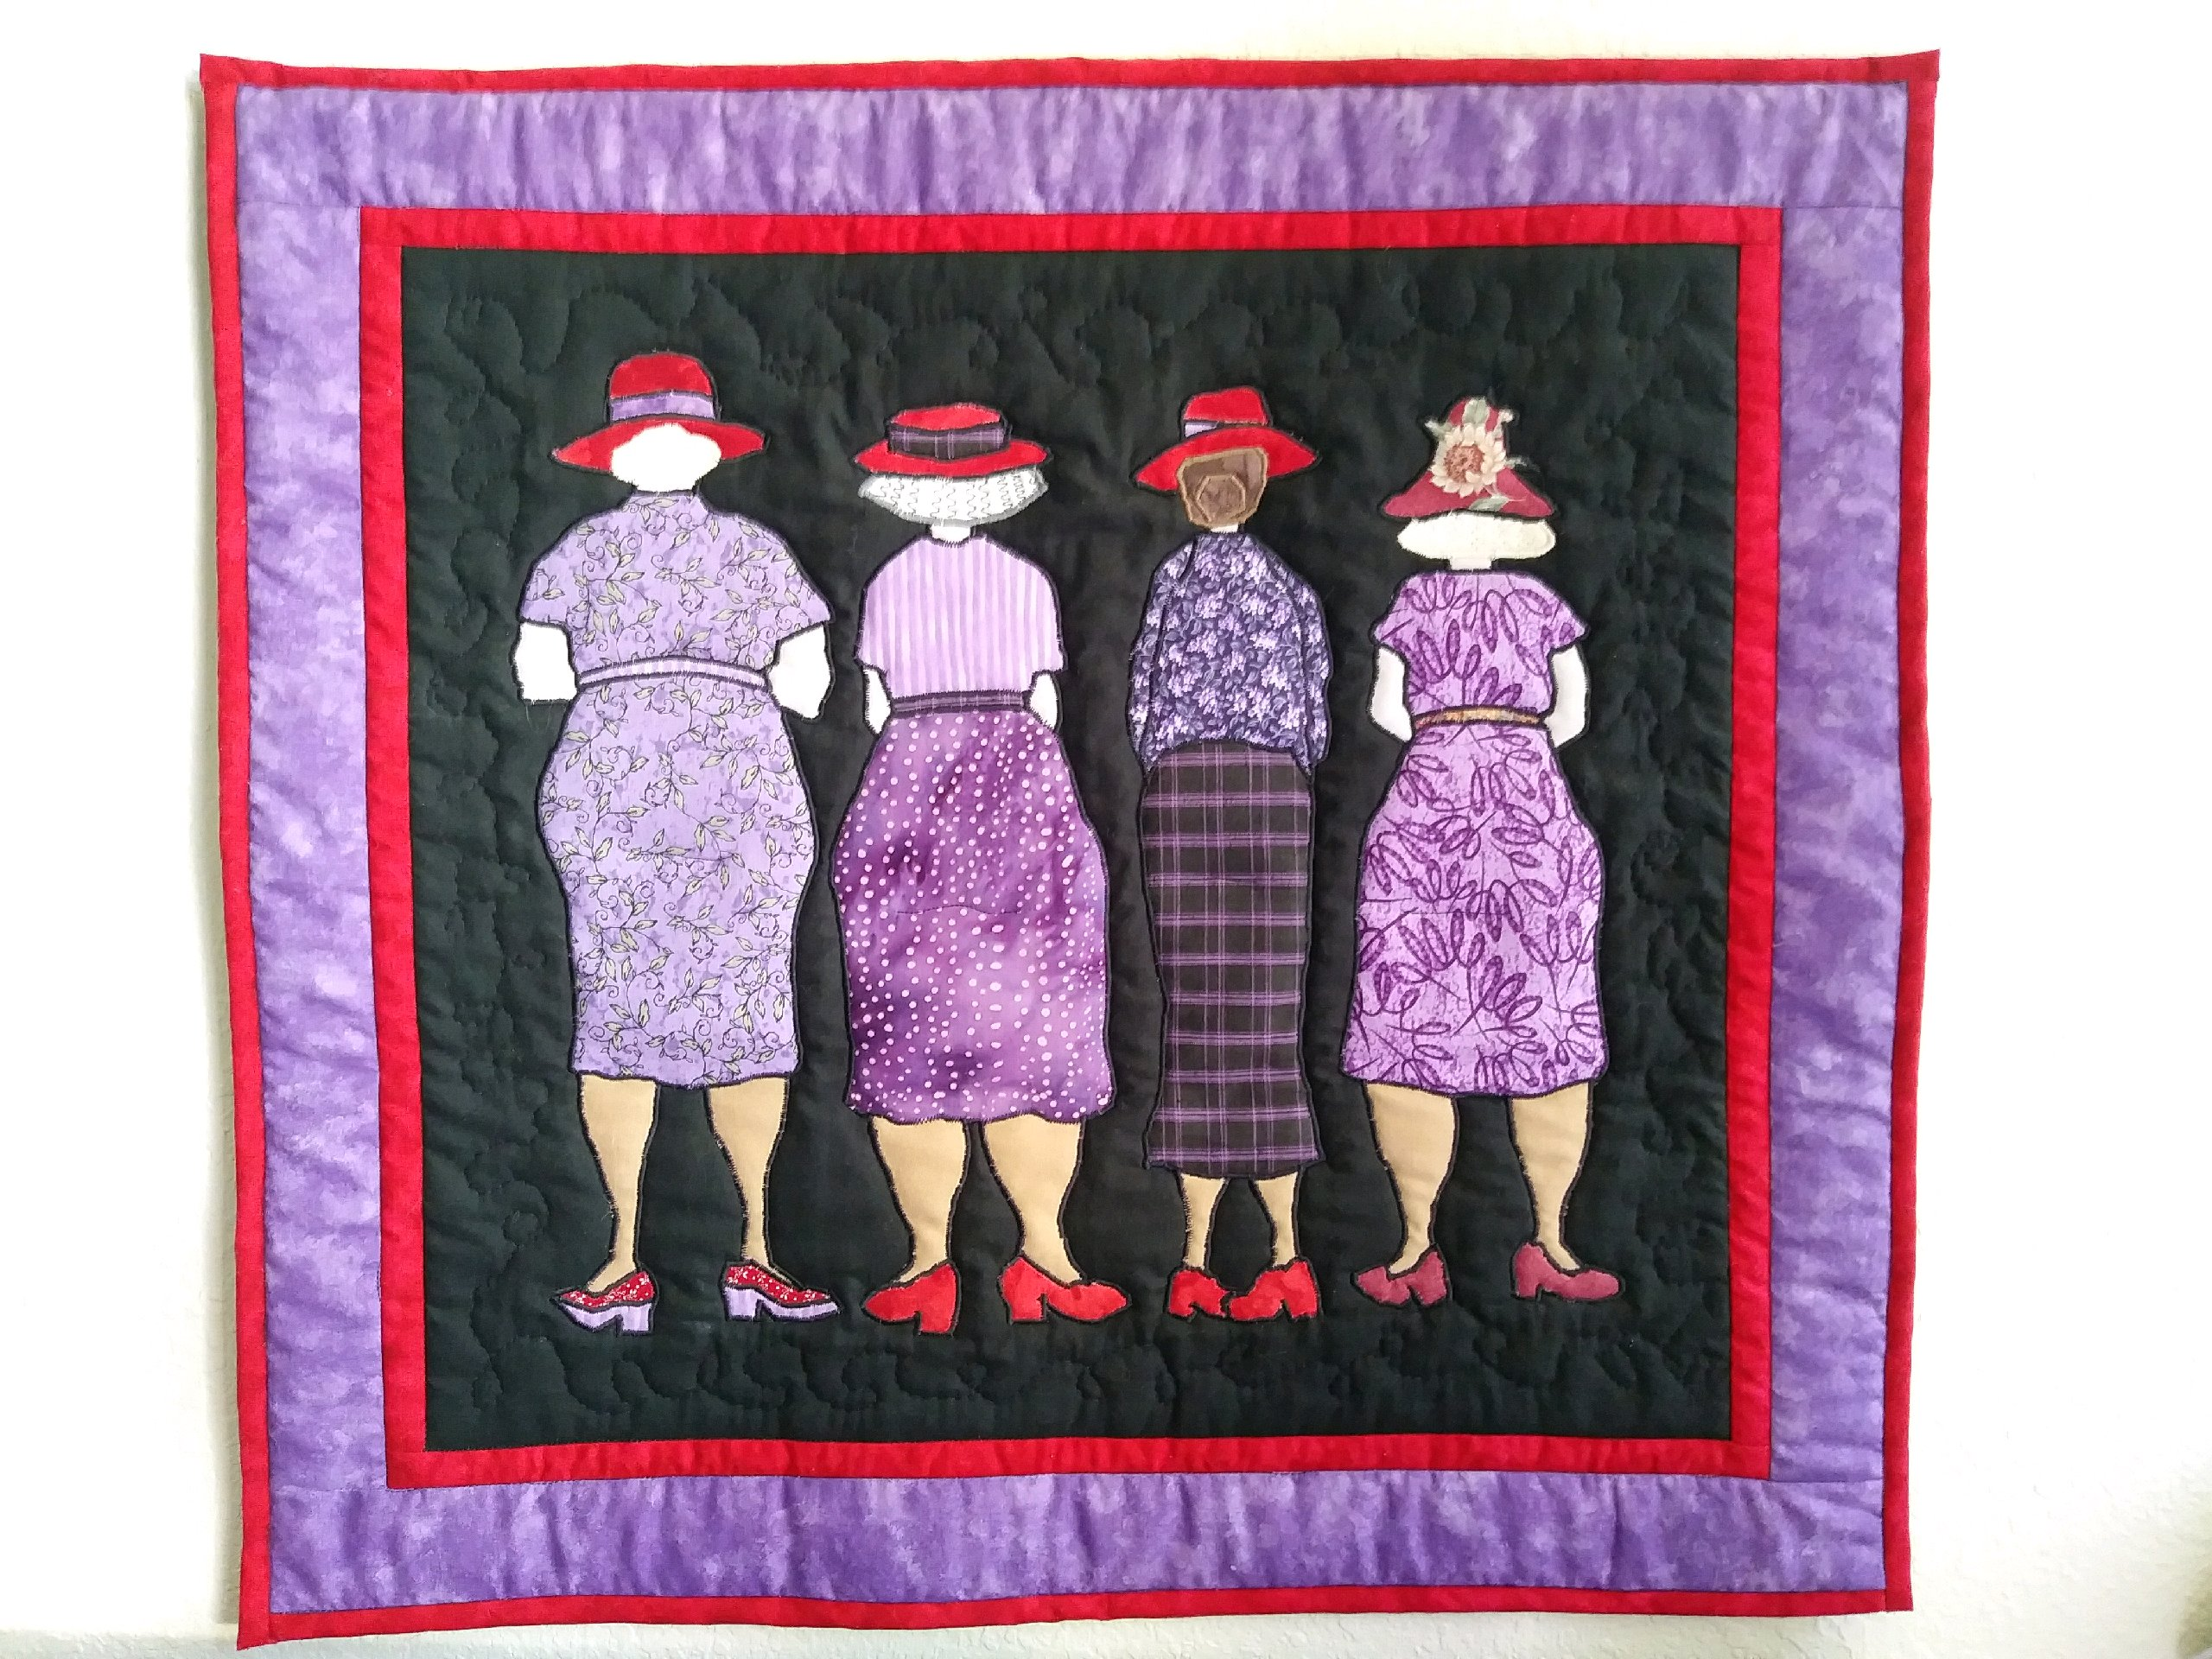
This is one of my early quilts and I picked the fabric. When I started quilting, I was interested in pictures.
Made this for my
Red Hat Mom!
We All Have Our Differences.

Slide 5
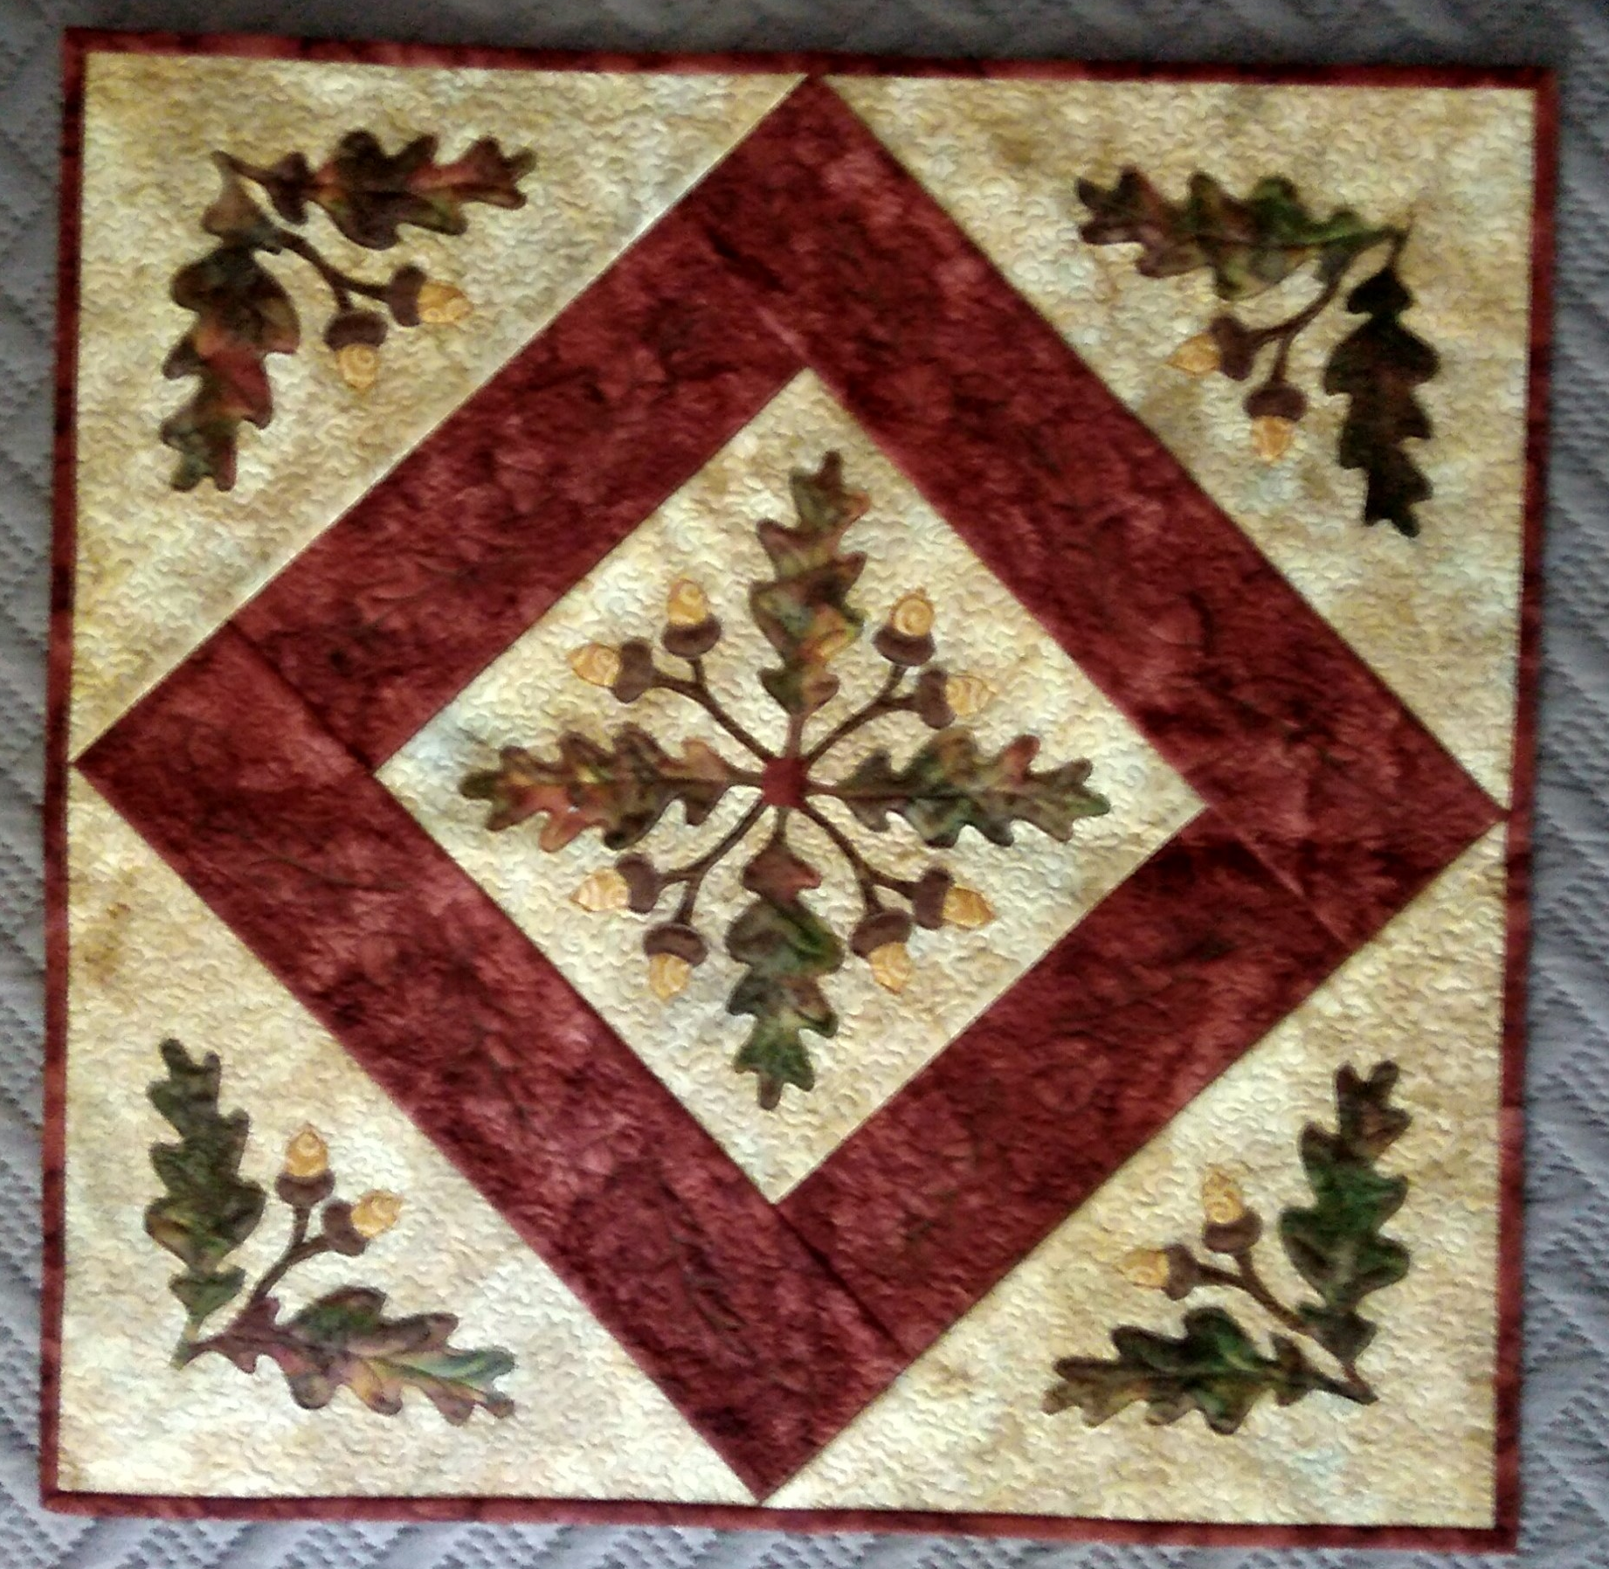
Please forgive my amateur photography!
This is my own design, sort of.
I took a class with Joanie Zeier Poole and bought some of her quilting designs.
I didn’t think it would work on any of my quilts, so I used it to create this applique, and managed a tiny meander in the background!

Slide 6
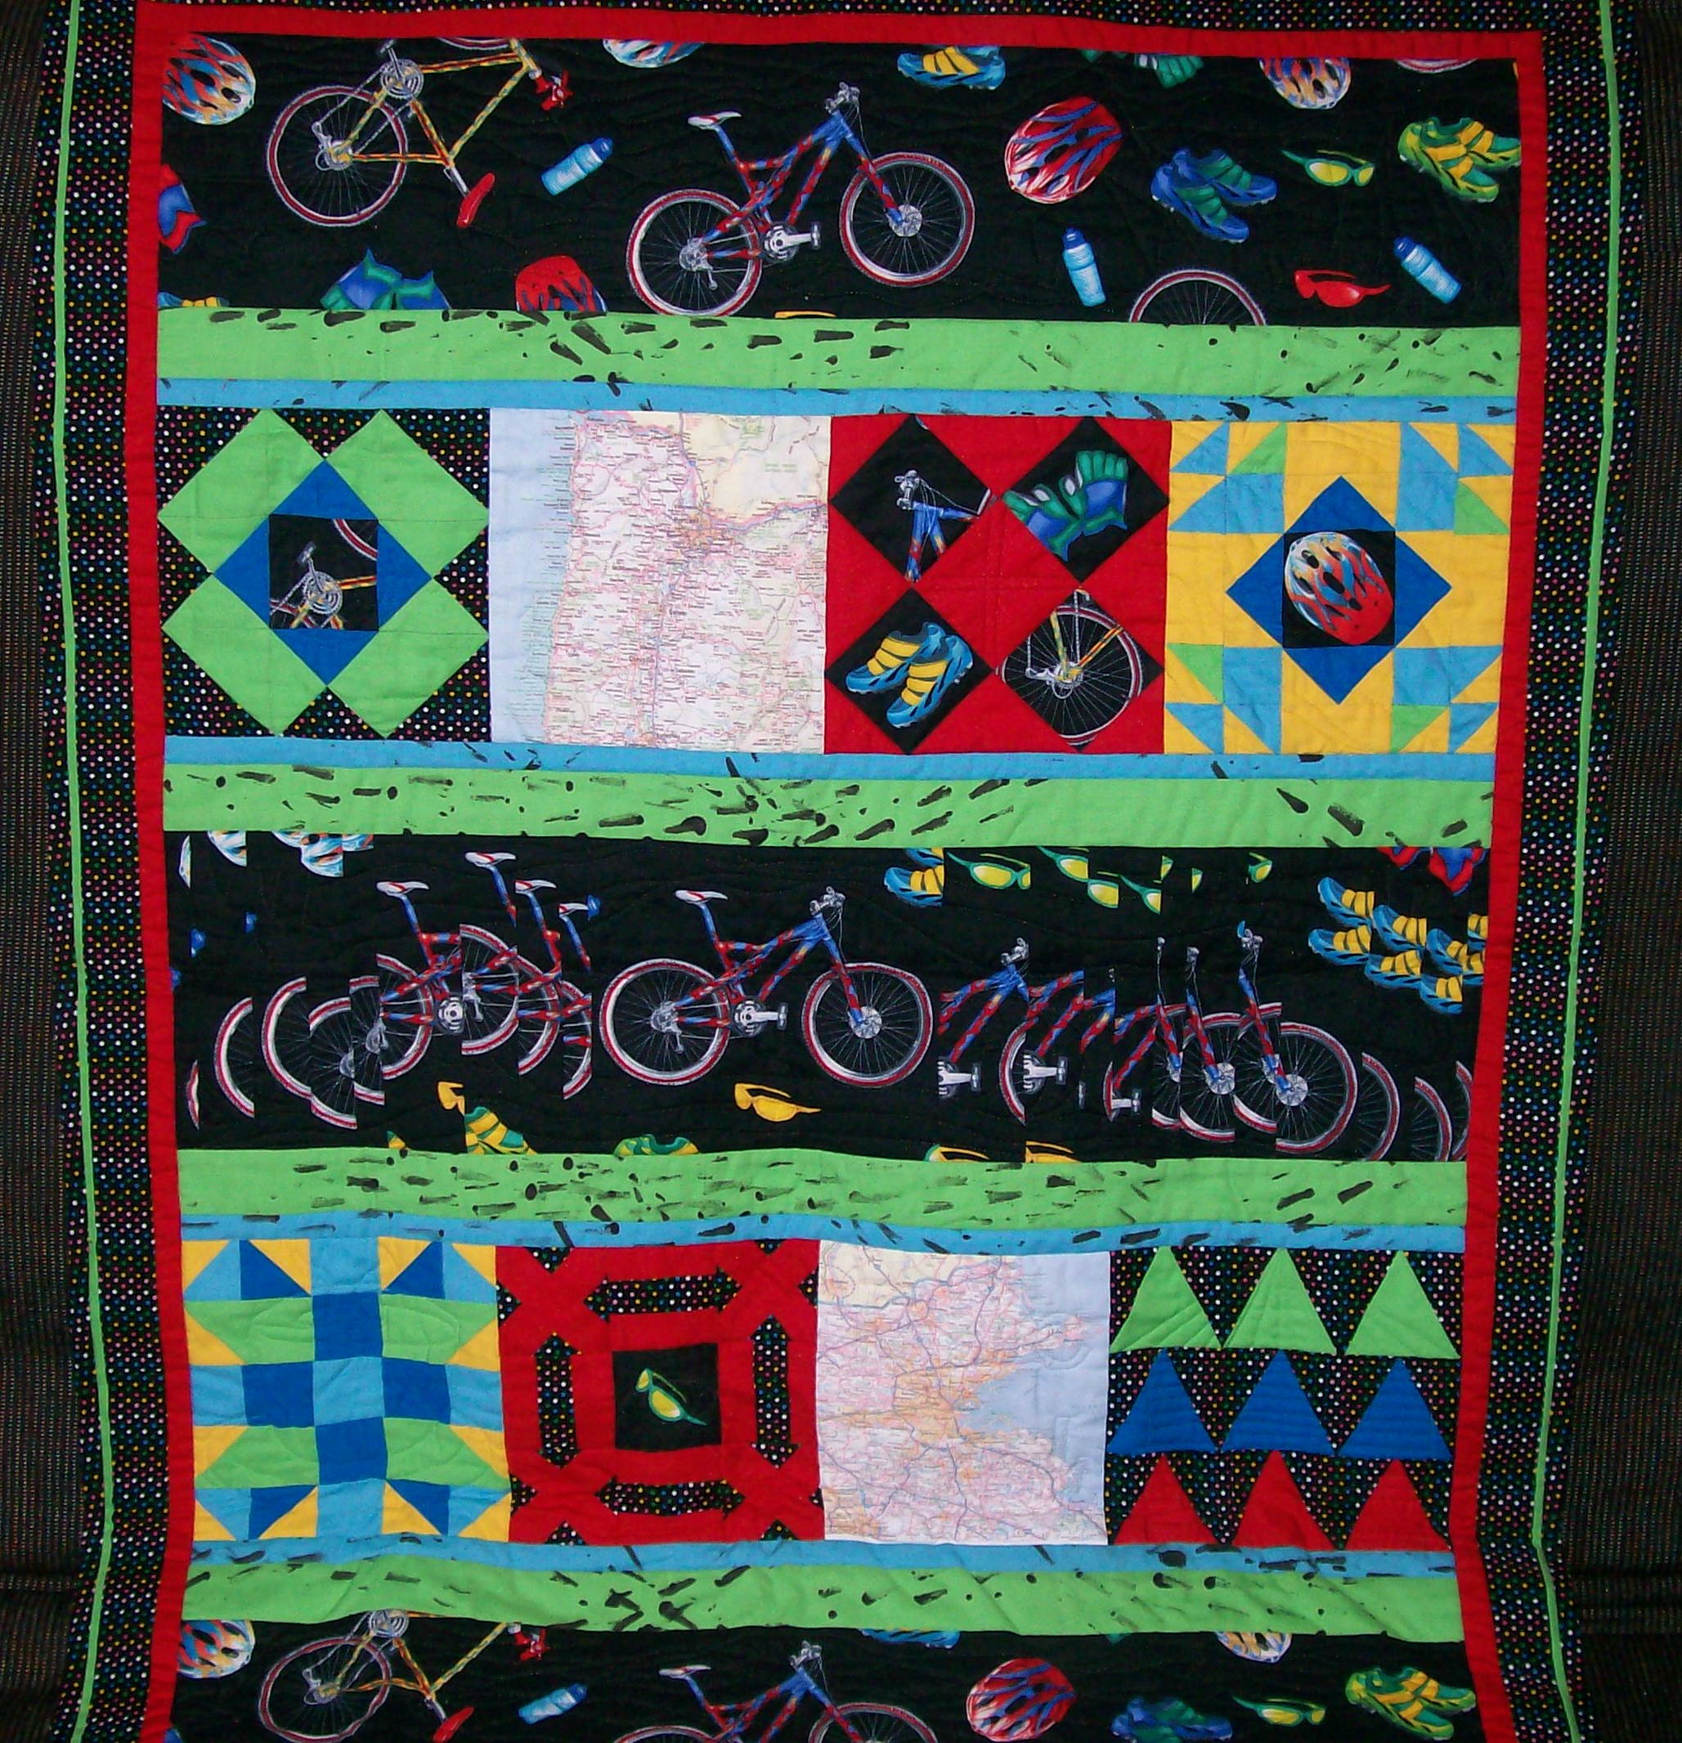
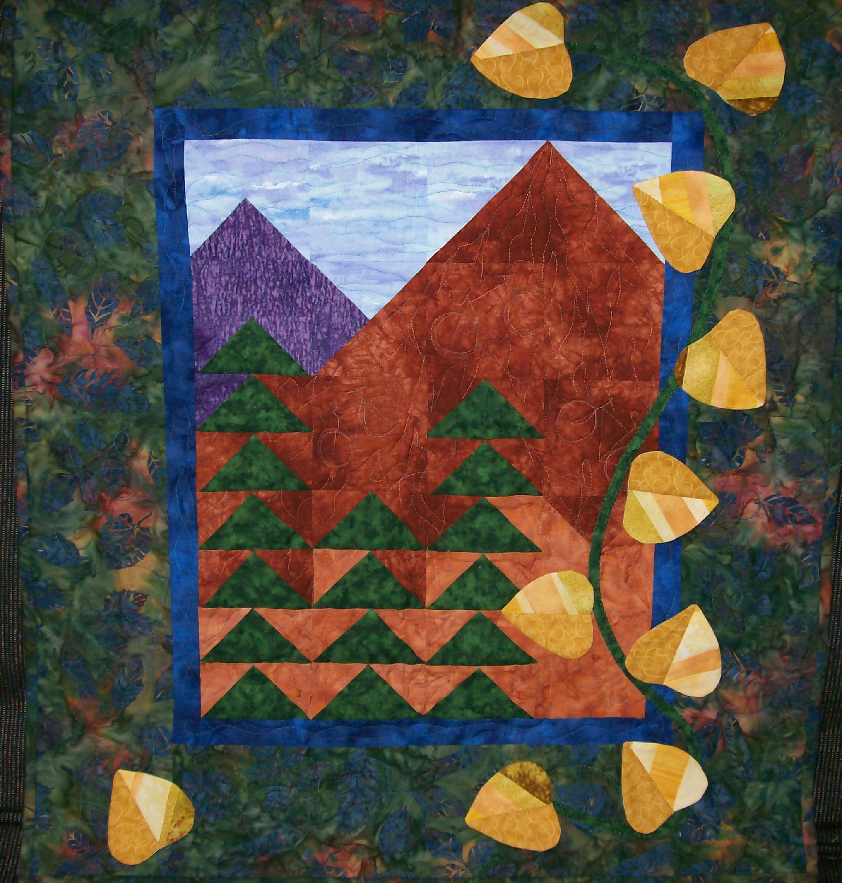
This was an early creation.
Wallhanging made for my oldest brother when he rode his bike across America.
Found this great bicycle print and picked blocks that meant something to his trip. Even painted the green sashing with a bicycle tire.
I’ve made several quilts for Brad. He appreciates the craft!
Below is another one for Brad.
Biking in the Rockies.

Slide 7
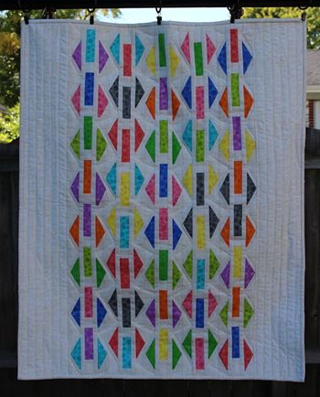
Made this one with my own hand dyed fabric (done in an SCQG workshop) and a pattern and template from Debbie Wesenberg.
Even quilted it myself.
I actually sold this one!

Slide 8
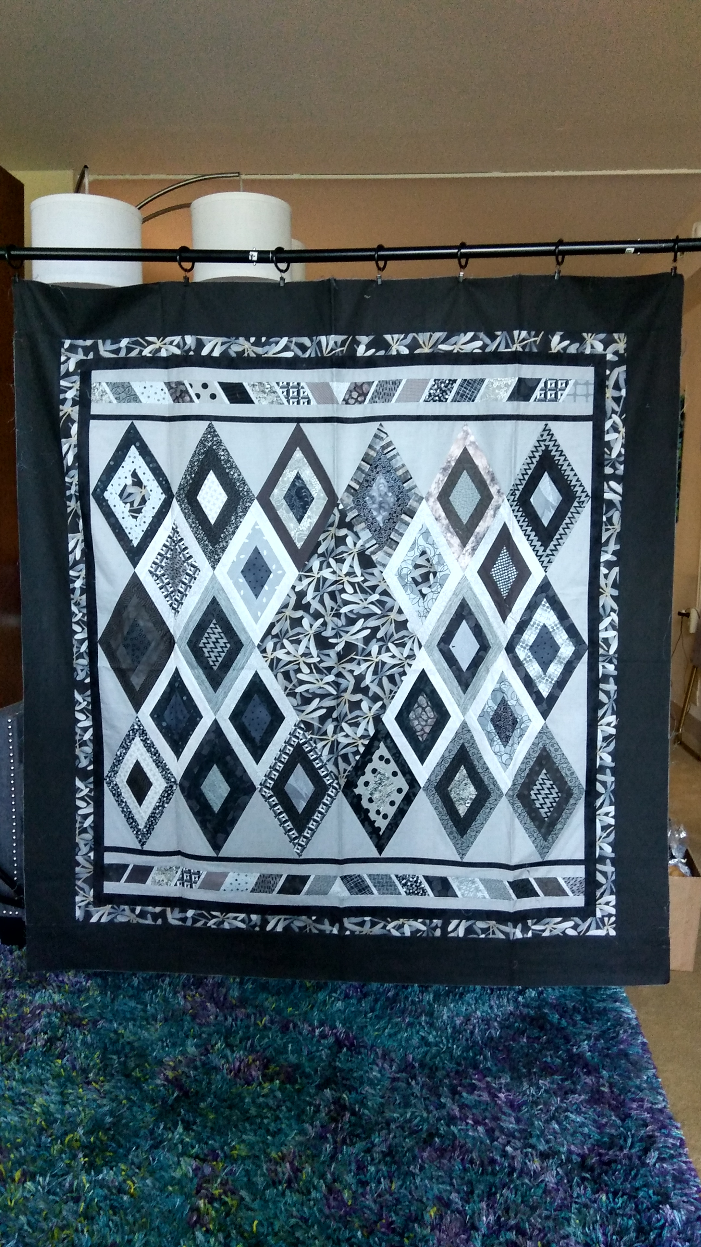
When my brother Dean and his girlfriend redecorated their bedroom in gray, I decided to make them a quilt in 50 shades of gray. Frank Karls custom quilted it with whips and handcuffs in the border, in a nod to the book.
This image is a smaller version. Original is king size.

Slide 9
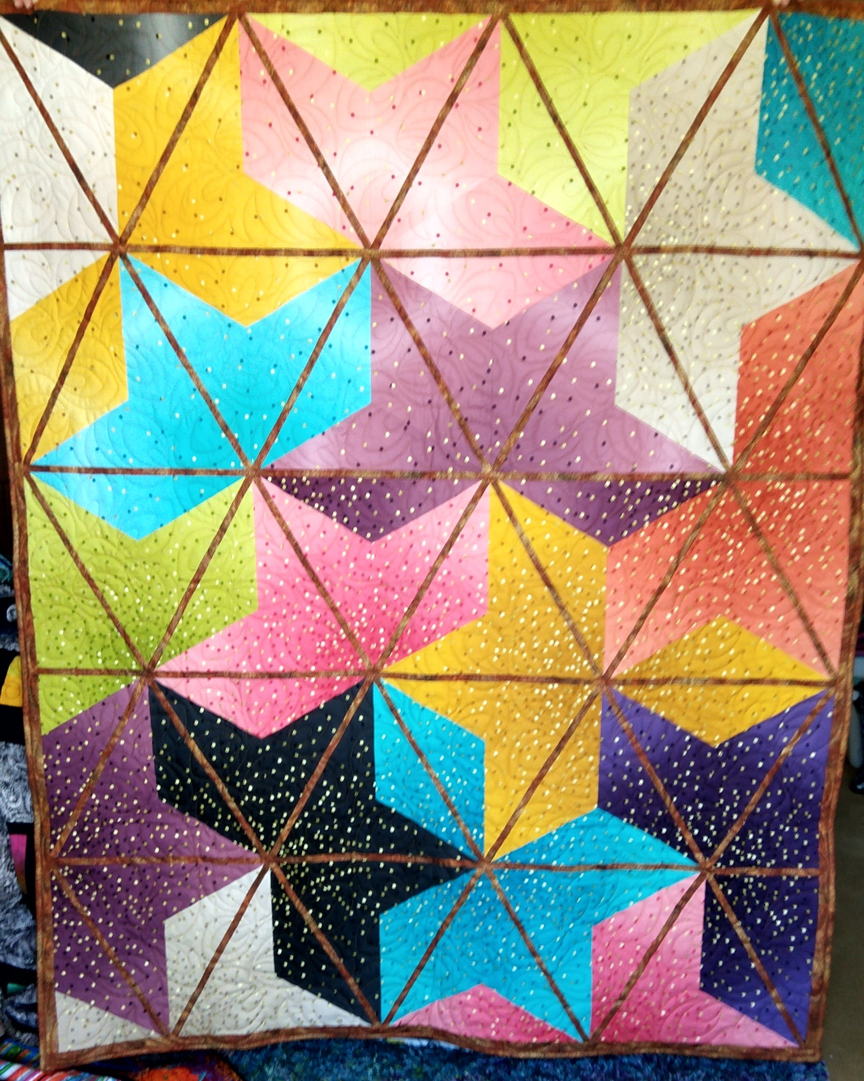
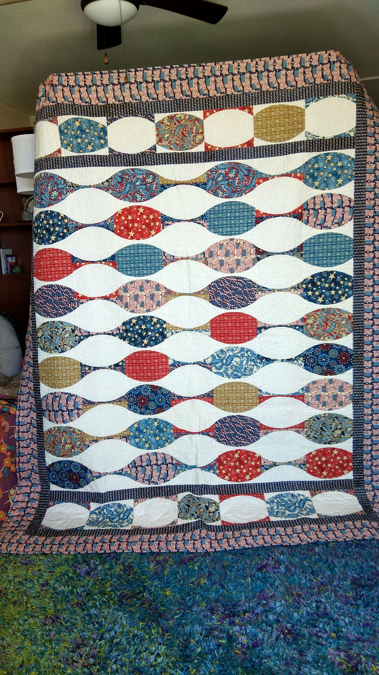
Sometimes I find an interesting new ruler project. Here are two of them.
American Abacus on the left and
Ombre Blossoms on the right.
These help me improve special skills, like curved piecing and Y-seams.

Slide 10
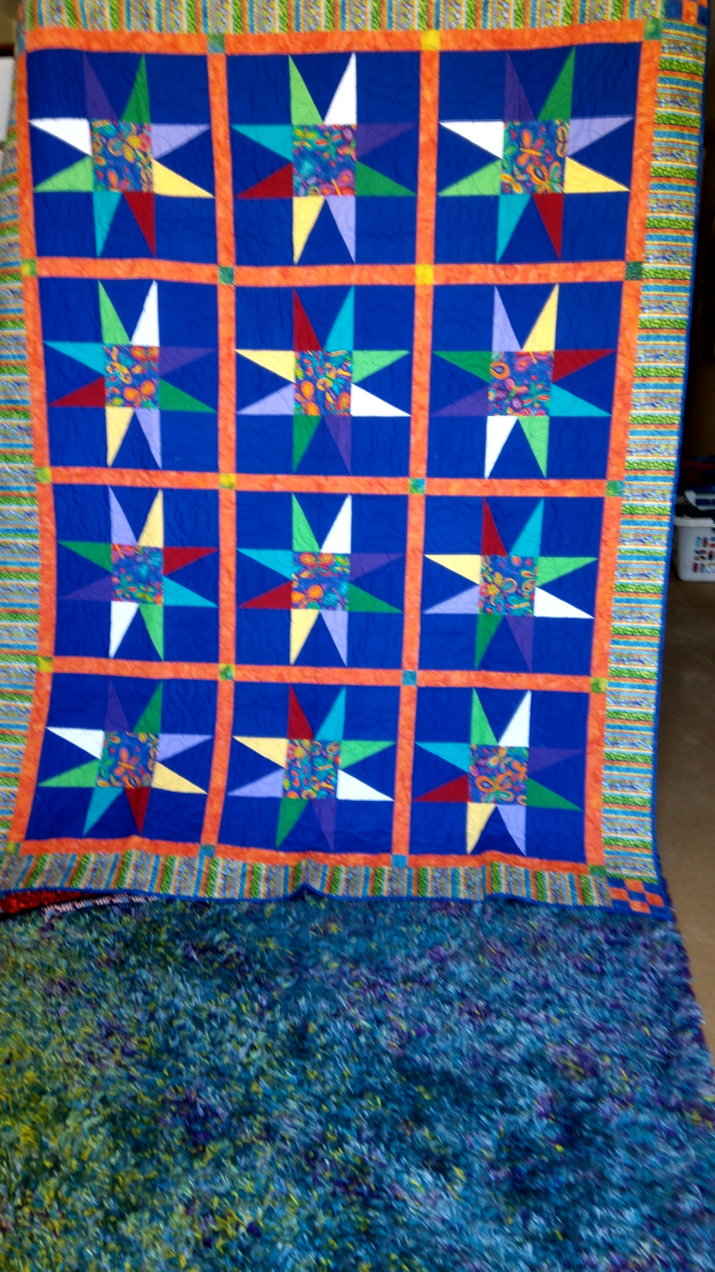
This one warms my heart!
I found these blocks at a quilter’s estate sale. She had put a note in the package that said “Orange Sashing?”
I made sure to honor her wishes!

Slide 11
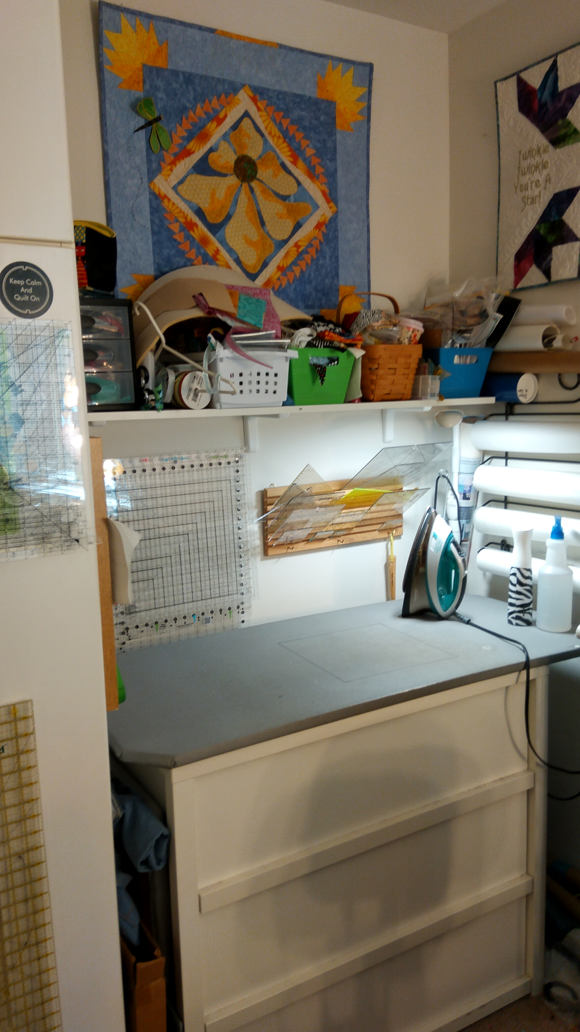
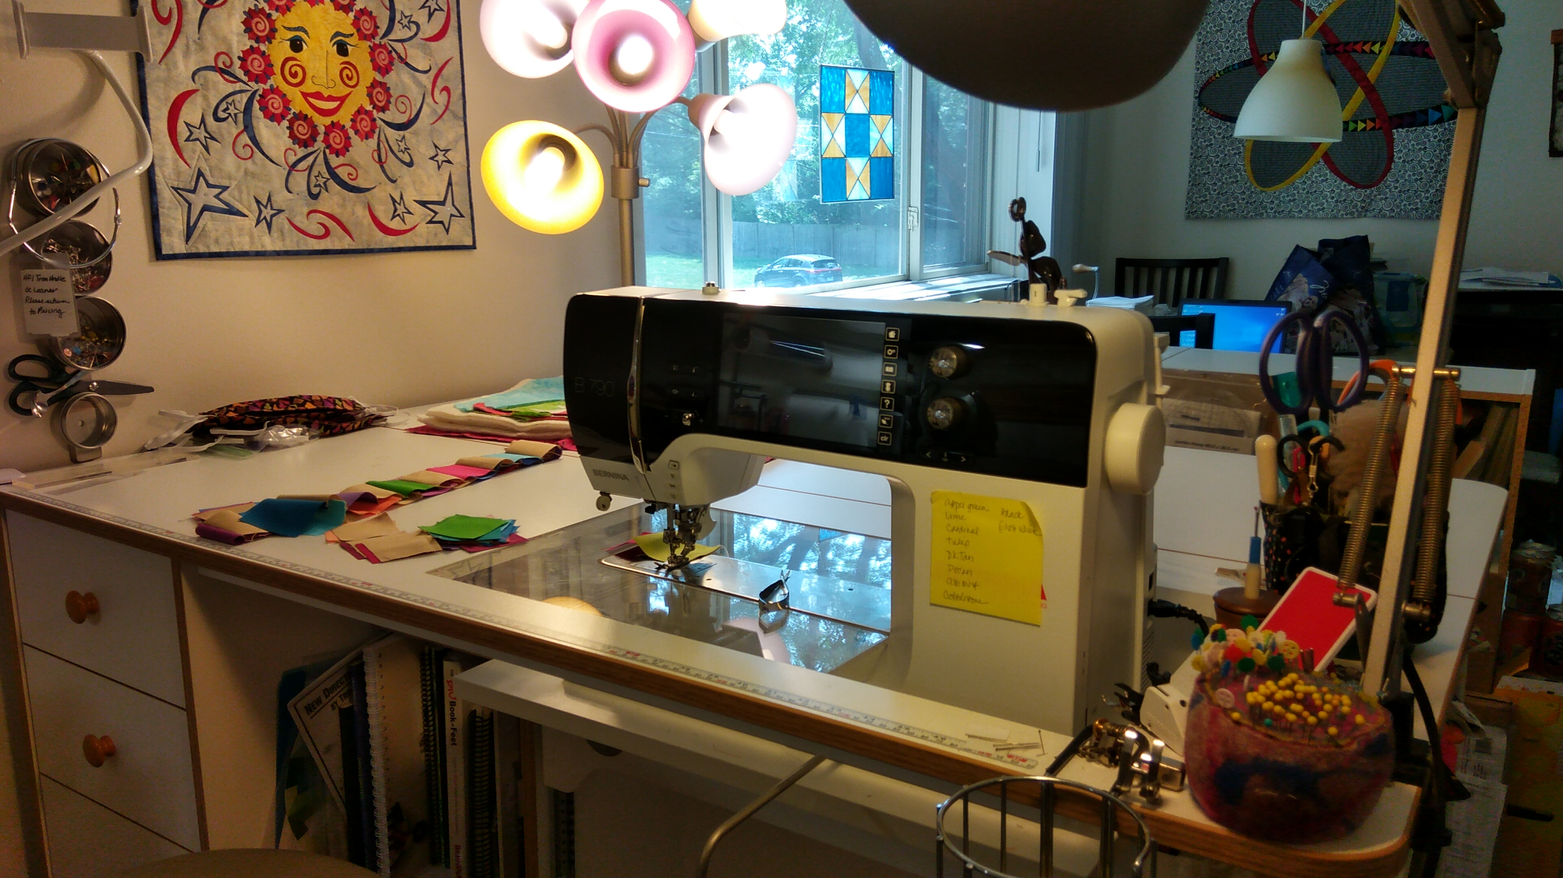
The Artist’s Studio
(or Dining Nook, depends how you furnish it!)
It’s amazing how much you can fit into a 8’x7’ space!

Slide 12
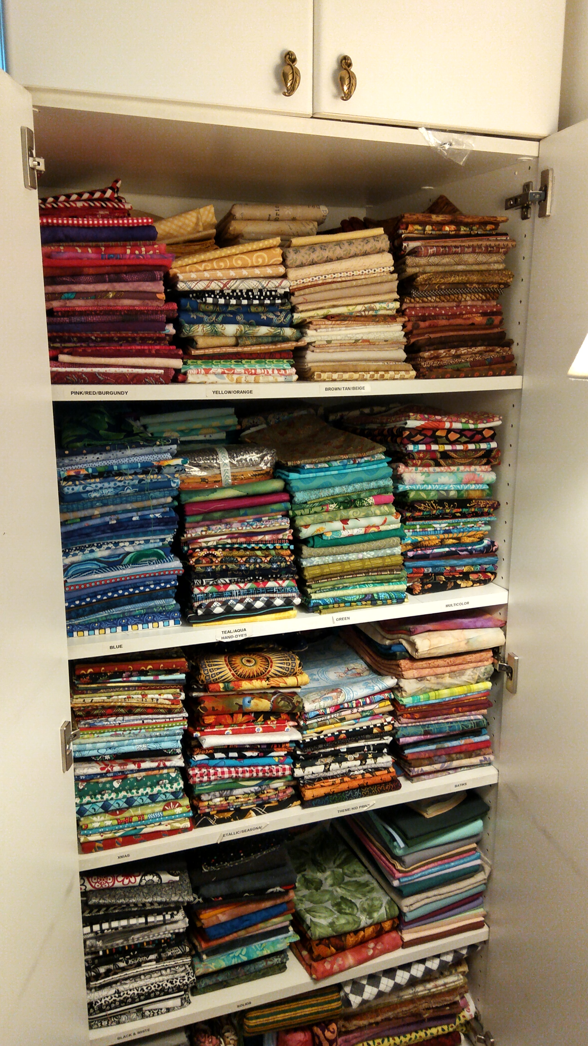
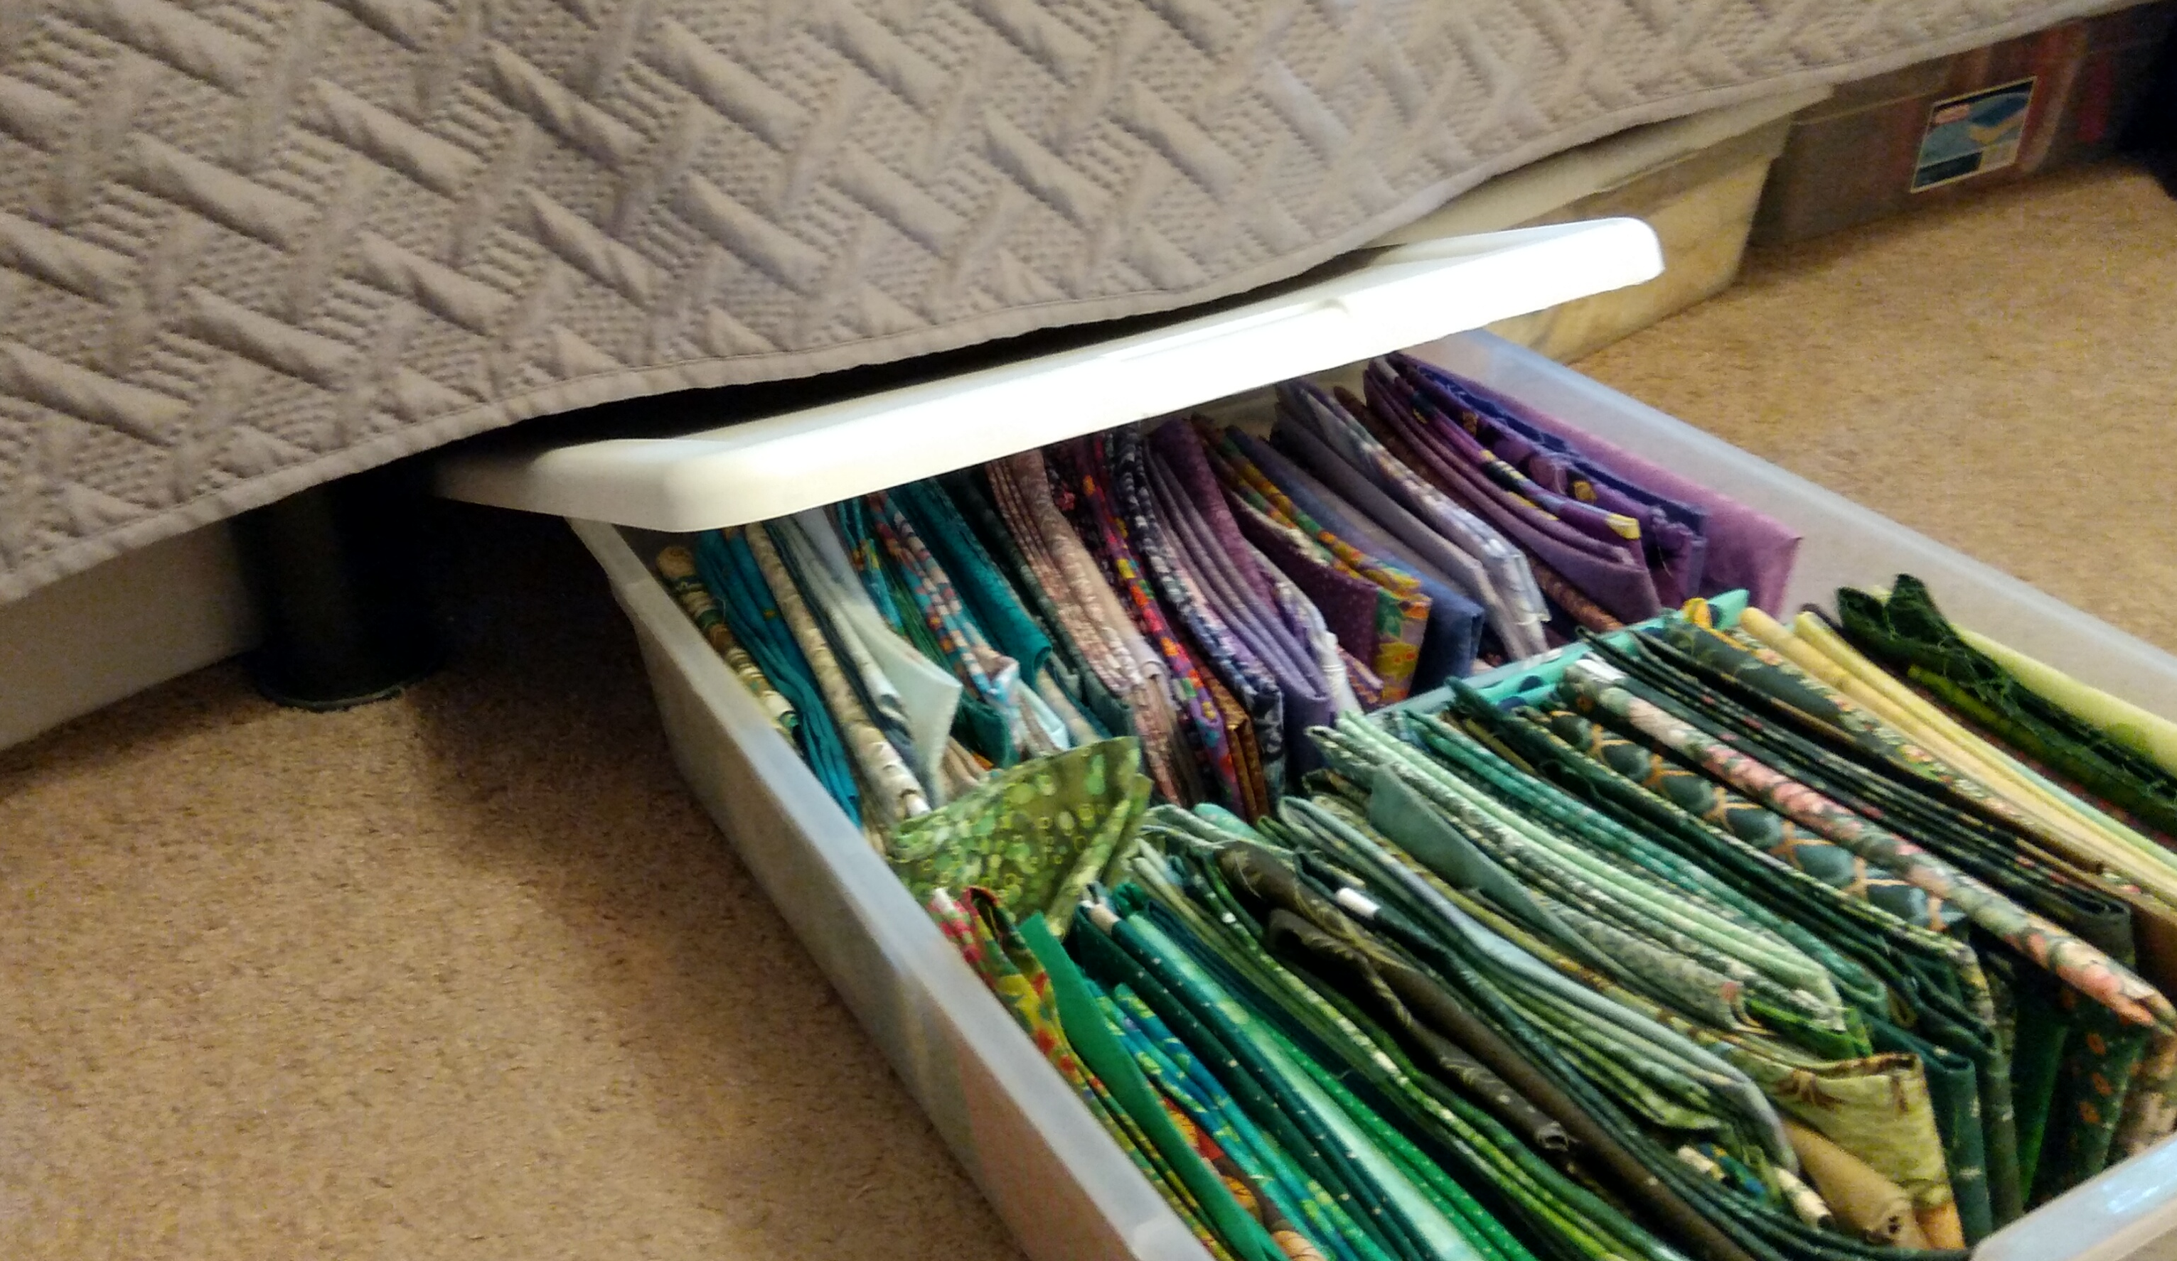
But the fabric stash doesn’t fit in the nook! It’s in the bedroom.
Two rows deep in the cabinet, with fat quarters under the bed!

